Slide 1
Project Management Single Page Application
Arindam Banerjee
Bhupendra Janghel
Hemlata Patel
Kiran Konduri
Rohit Patel
Sonali Gupta

Slide 2
Objective
The Project Management Single Page Application allows you to manage projects and their respective tasks.
User: Add/Edit/View/Delete
Project : Add/Edit/View/Delete
Task : Add/Edit/View/Delete

Slide 3
TECHNOLOGIES
FRONT END
Angular
Bootstrap
SERVICE LAYER
SpringBoot
Spring Microservices
Eureka Server
Netflix zuul
Rest API
BACK END
MySQL

Slide 4
Cloud Platform
Front End: Google Firebase
Microservices: Salesforce Heroku
Database: Microsoft Azure

Slide 5
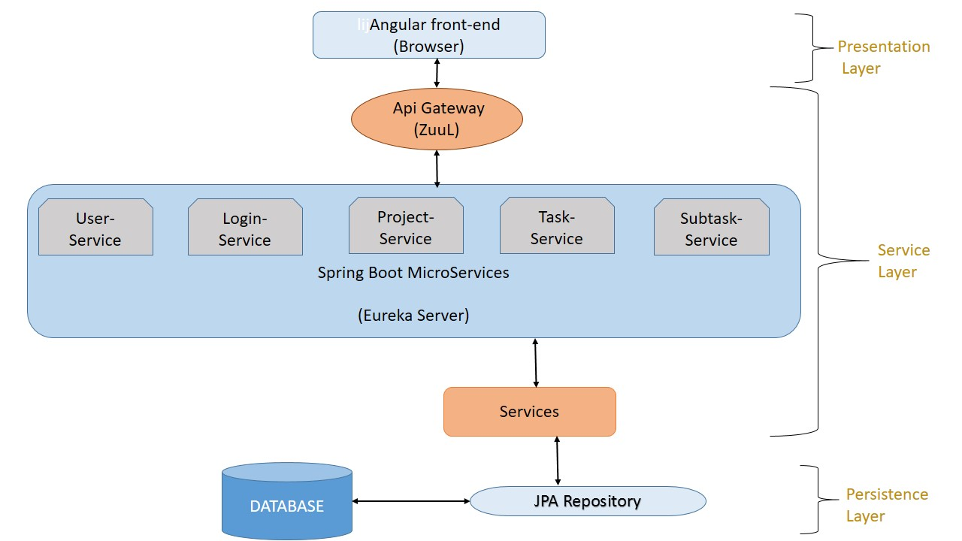

Slide 6
Thank You

